Slide 1
Structure and Guidance for Organizing Applications within Visual Studio
Keith Elder
Quicken Loans
Manager, Sr. Software Engineer
Microsoft MVP
Keith a t keithelder dot net
Blog: http://keithelder.net/blog/

Slide 2
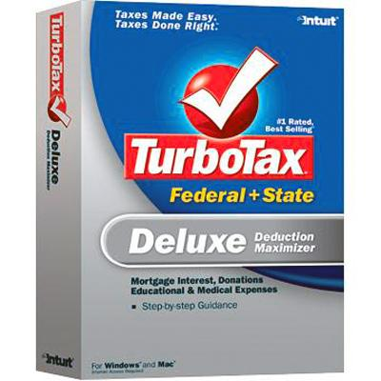

Quicken Loans

Slide 3









About Quicken Loans
Originally founded in 1985 as Rock Financial by Dan Gilbert
  Grew to one of the largest independent mortgage banks in the country
  1998 IPO
  1999 Launched Rockloans.Com
1999 Intuit, Inc (makers of TurboTax and Quicken) purchased Rock Financial.
July 2002 Dan Gilbert purchased Quicken Loans back from Intuit. Retained Quicken Loans branding and marketing initiatives.
4500 employees
Largest online retail home loan lender

Slide 4





Deep Fried Bytes is an audio talk show with a Southern flavor hosted by technologists and developers Keith Elder and Chris Woodruff. The show discusses a wide range of topics including application development, operating systems and technology in general. Anything is fair game if it plugs into the wall or takes a battery.
http://deepfriedbytes.com

Slide 5
Take Aways
Covering the basics of solutions and projects
Things to consider before setting up your projects
Configuring the project
  Initial project creation
Organizing our project
Handling Third Party Assemblies

Slide 6
Why Should We Care About How We Organize Our Projects
Localize Changes
  Minimizes impact on other parts
  Eases application maintenance
  Enhances overall flexibility
Separation of Concerns
  Example: UI, data access, business logic
  Flexibility, maintainability, scalability
Components should be reusable
Independent teams should be able to work on parts of solution with minimal dependencies on other teams

Slide 7
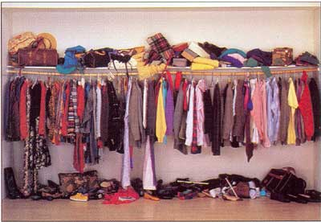
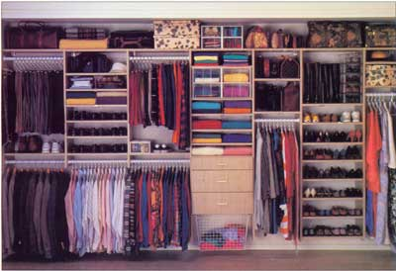
Your Mom Was Right!
Web Services
Business Logic
Mobile
Database
Minimizes impact on other parts
Eases application maintenance
Enhances overall flexibility
User Interface
Components
How about this?
Ever seen projects that look like this?

Slide 8

elderism
Messy projects take longer to understand and will only get messier.

Slide 9
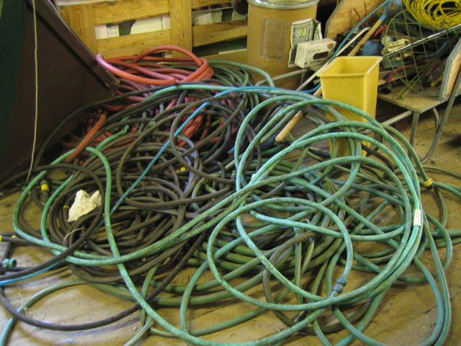

Task: Take my water hose and setup a sprinkler in my yard.
This is how your code looks to new team members if you don’t think about structure.
Being organized makes maintenance and future growth easier.
It is easier to be messy. Takes higher level thought to be organized.

Slide 10
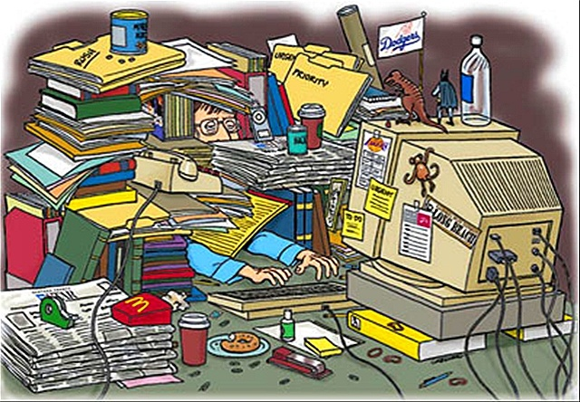
The Joy of Wallowing in a Perfect Mess

Slide 11
What did we learn?
Localize Changes
Separate Concerns
Help your team members
m
a
r
O
e
a
n
t
r
g
a
i
t
i
O
z
t
s
n
ORGANIZATION MATTERS

Slide 12

Basics

Slide 13
Projects and Solutions
Projects – all files belong to a project
Library
Windows Form
Component
Solutions – are what you deploy
Accounts Payable
Business Layer
Accounts Payable
Business Layer
Interface
Interface
Web Application
Windows
Application
Common
Inventory
Common
Inventory
Components
Accounts Receivable
Data Layer
Components
Accounts Receivable
Data Layer
Payroll
Payroll

Slide 14
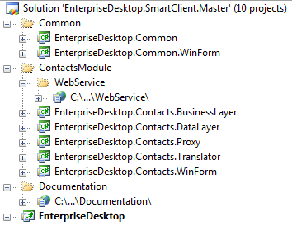
Example
Solution
Solution Folders
Projects

Slide 15
Three Solution Types

Slide 16
Single Solution
Accounts Payable
Business Layer
Interface
Common
Inventory
Accounts Receivable
Data Layer
Components
Payroll
Really Cool Piece of Software
Visual Studio Solution

Slide 17
Single Solution
Single
  Advantages
    Leverage project references
    Simplified build process
  Disadvantages
    Development takes longer on larger projects
    Build wait times increase
    Model scales only so far
    Even minor (non-breaking) changes to a single source file within a single project can result in a rebuild of many projects within the solution, due to project dependencies.

Slide 18
Multiple Solutions
D
C
E
A
B
F

Slide 19
Multiple Solutions
Multiple
  Advantages
    Limit work to small subsystems
    Solution explorer remains less cluttered
    Leverage project references in each solution
    Master solution allows you to easily rebuild the entire system
  Disadvantages
    When new projects are created you need to add the project to multiple solution files.

Slide 20
Master Solution
This is your continuous integration build.
Accounts Payable
Business Layer
Interface
Accounts Payable
Interface
Common
Inventory
Common
Inventory
Components
Accounts Receivable
Data Layer
Accounts Receivable
Data Layer
Payroll
Payroll
Business Layer
Business Layer
Interface
Common
Inventory
Common
Inventory
Accounts Receivable
Components
Data Layer
Payroll

Slide 21

Before you write a single line of code

Slide 22
It Starts With The Namespace
Company
Team
Product
Layer
Company
Product
Module
Layer
Examples
Microsoft
Practices
EnterpriseLibrary
WidgetsRUs
Helpdesk
Notes:
Agree upon a standard namespace within your organization
Typical guidance dictates you preface your namespace with your company name
Once a namespace and a project name are determined you can then and only then start to create your project structure. Your namespace then becomes how you map your projects to the file system. The next slide shows how this is done. Remember, you MUST do this before you start writing code because refactoring this into another name later on is a pain and not fun.
Single Solution - When modularity doesn’t apply
One page web form
One form Smart Client or Winform
Multiple Solutions - When modularity does apply
Enterprise Services
Enterprise Web Applications
Enterprise Smart Clients
Do not confuse modularity with n-tier architecture design
BusinessLayer
DataLayer
WorkFlow
User Interface

Slide 23

Where do these projects go?

Slide 24
C:\Dev\MyApp
Folder Structure For Application
Source
Module
HelpDesk
Project Folder
Services
BusinessLayer
Project
Folders
Company.MyApp.HelpDesk.BusinessLayer
DataLayer
WorkFlow
Company.MyApp.HelpDesk.DataLayer
UI
WinForm
Web
Company.MyApp.HelpDesk.UI.WinForm
Mobile
Company.MyApp.HelpDesk.UI.Mobile
Common
ThirdPartyAssemblies

Slide 25
elderism
Adding a project to a late project makes it later.
The Mythical Man-Month, Fred Brooks, “Adding manpower to a late software project makes it later. “

Slide 26

Where are the solution files?
Source Folder
Master Web
Master Mobile
Master WinForm
CI
Helpdesk Service

Slide 27
Real world example
Interface
Accounts Payable
Business Layer
Interface
Accounts Payable
Business Layer
Interface
Accounts Payable
Business Layer
Interface
Accounts Payable
Business Layer
Common
Inventory
Common
Inventory
Common
Inventory
Common
Inventory
Components
Accounts Receivable
Data Layer
Components
Accounts Receivable
Data Layer
Components
Accounts Receivable
Data Layer
Components
Accounts Receivable
Data Layer
Payroll
Payroll
Payroll
Payroll
WEB
MOBILE
SERVICE
SMART CLIENT
DataLayer
Database
Business
Workflow

Slide 28
Those pesky third party assemblies

Slide 29
C:\Dev\MyApp
Third Party Assemblies
Source
ThirdPartyAssemblies
Can put DLL here, wouldn’t recommend strong named assemblies.
Name of Library
Version1
Version2
Allows you to version libraries. On larger projects the whole system may not change at once.
Projects use a relative path of: ../../../
Developers can checkout source control and do a build
And, so can your automated build server!

Slide 30

Did you test it though?

Slide 31
C:\Dev\MyApp
Tests
Source
Tests
Each project should have a corresponding tests project.
While it doesn’t matter *where* you put your tests projects, we’ve found it easier to deal with them all in one location.
Pick a standard, stick to it.
Inventory.Tests
Inventory.BusinessLayer.Tests
UI.Web.Tests

Slide 32
Demo
Creating Our Application: SkunkWorks ERP

Slide 33
Resources
My Blog
  http://keithelder.net/blog/
  http://keithelder.net/presentations/
  http://deepfriedbytes.com
Email
  Keith a t keithelder dot net
Resources
  http://shrinkster.com/oqh (team development with visual studio)

